Slide 1
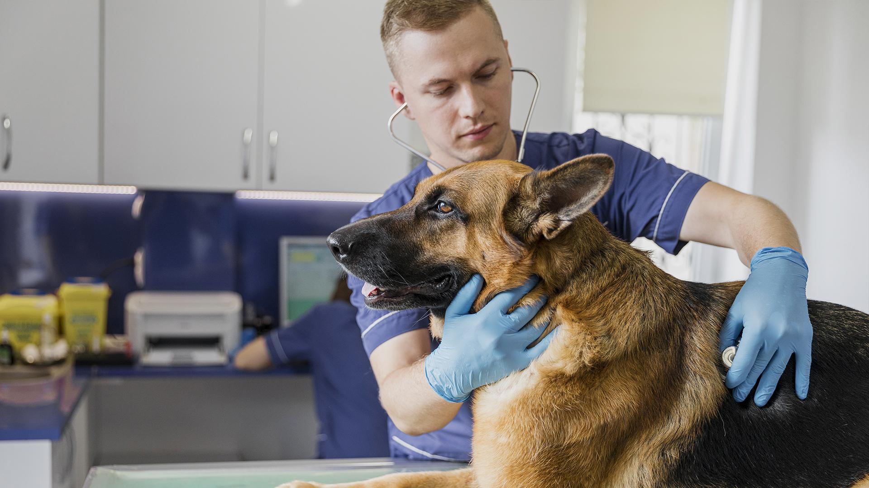
Database Management System for Local Animal Shelter
IS680 Database Management Systems
Group 5

Slide 2

Purpose
centralized platform to streamline data management
reduce human error
improving the shelter's operations and decision-making capabilities
need to track euthanized animals
address the lack of adoption
drivers enhance the adoption process

Slide 3
Needs and Goals
01
02
03
04
DETAILED RECORDS
STREAMLINED PROCESS
TRACK RESOURCES
ROBUST REPORT AND ANALYTICS
species, breed, age, health status, and adoption status.
comprehensive adoption process
volunteers, the tasks they perform, and the hours they have worked
analytics to gain insights and centralize the shelter's data

Slide 4
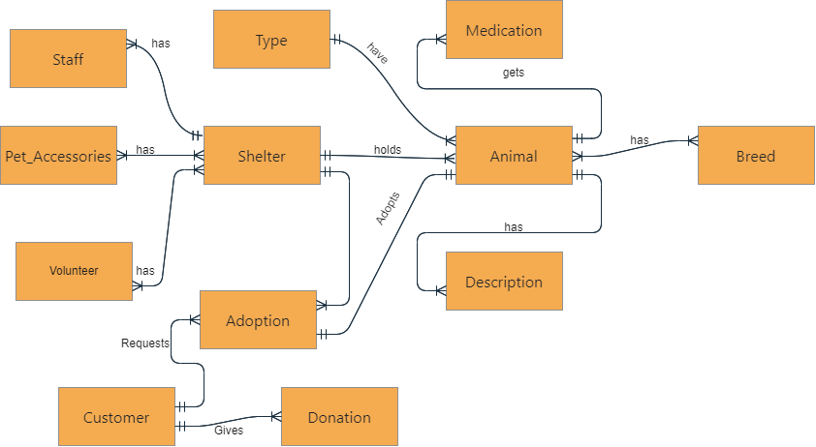
CONCEPTUAL DIAGRAM

Slide 5
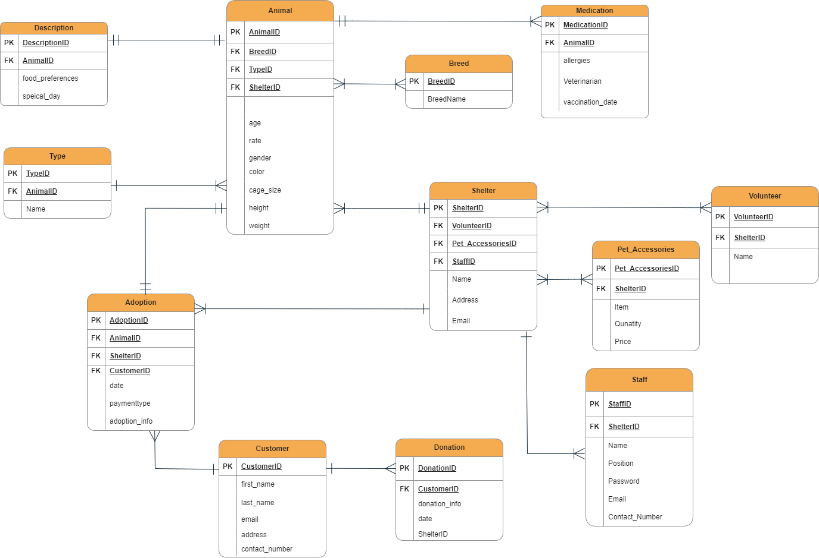
ER DIAGRAM

Slide 6

Benefits
Standardization Across Multiple Users
User Roles and Access Privileges
Centralized Data Storage
Elimination of Synonyms
Improved Data Consistency
Reduced Errors
Enhanced Reporting

Slide 7
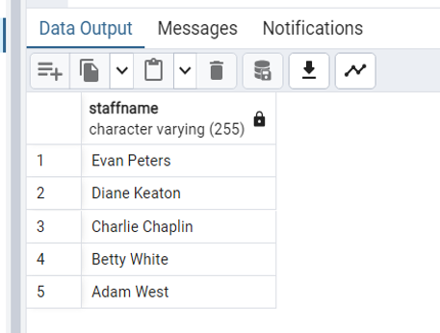
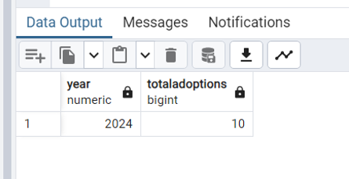
List all staff members who have not been assigned any animals
Find the total number of animals adopted each year, along with the year
SELECT s.Name AS StaffName
FROM Staff s
LEFT JOIN Animal a ON s.ShelterID = a.ShelterID
WHERE a.AnimalID IS NULL;
SELECT EXTRACT(YEAR FROM date) AS Year, COUNT(*) AS TotalAdoptions
FROM Adoption
GROUP BY EXTRACT(YEAR FROM date);

Slide 8
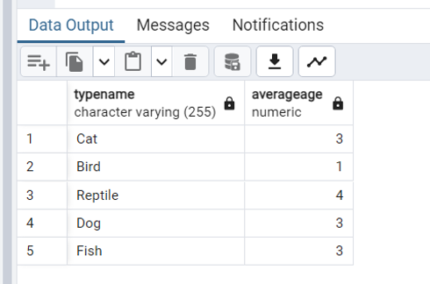
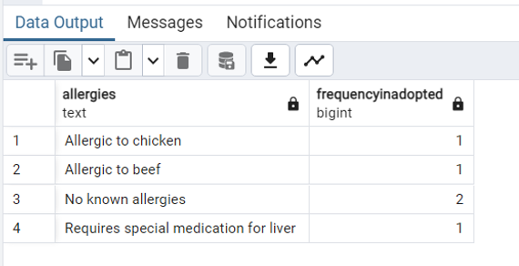
List the average age of animals at the time of adoption by Type name.
Identify any medical conditions that appear more frequently in adopted animals than in non-adopted ones.
SELECT t.Name AS TypeName, Round(AVG(a.age)) AS AverageAge
FROM Adoption ad
JOIN Animal a ON ad.AnimalID = a.AnimalID
JOIN Type t ON a.TypeID = t.TypeID
GROUP BY t.Name;
SELECT m.allergies, COUNT(*) AS FrequencyInAdopted
FROM Medication m
JOIN Adoption ad ON m.AnimalID = ad.AnimalID
GROUP BY m.allergies
HAVING COUNT(*) > ( SELECT COUNT(*)
FROM Medication m2
WHERE m2.allergies = m.allergies AND NOT EXISTS (SELECT * FROM Adoption ad2 WHERE ad2.AnimalID = m2.AnimalID));

Slide 9
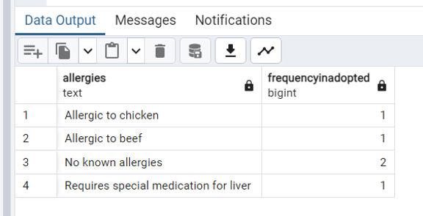
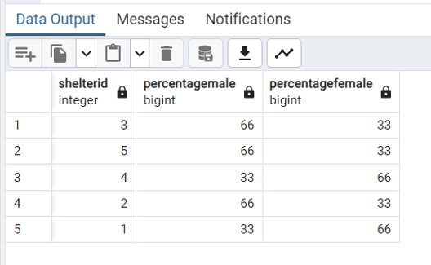
Find the percentage of male versus female animals in each shelter
Show the average weight of animals by type, ranking the types by average weight within each shelter
SELECT ShelterID,
100 * SUM(CASE WHEN gender = 'Male' THEN 1 ELSE 0 END) / COUNT(*) AS PercentageMale,
100 * SUM(CASE WHEN gender = 'Female' THEN 1 ELSE 0 END) / COUNT(*) AS PercentageFemale
FROM Animal
GROUP BY ShelterID;
SELECT t.Name AS TypeName, s.ShelterID, round(AVG(a.weight)) AS AverageWeight
FROM Animal a
JOIN Type t ON a.TypeID = t.TypeID
JOIN Shelter s ON a.ShelterID = s.ShelterID
GROUP BY t.Name, s.ShelterID
ORDER BY s.ShelterID, AverageWeight DESC;

Slide 10
Importance of the system
01
02
03
ADDRESSES THE KEY CHALLENGES
EMPOWERS THE SHELTER TO MAKE INFORMED DECISIONS
STRENGTHENS THE COLLABORATION
including the need for transparent euthanasia records
effective adoption drivers
centralized data management
based on real-time data and insights, leading to more efficient utilization of resources and improved animal welfare
between the shelter, hospital, and veterinarians, ensuring a comprehensive and coordinated approach to animal care

Slide 11

Improved adoption rates and successful placements through better matching of animals and potential adopters
Enhanced transparency and accountability in the shelter's operations, building trust with the community
Reduced euthanasia rates and better outcomes
Stronger engagement with the local community
Positive Impact on the Animal Shelter, the Animals, and the Community

Slide 12





MEET THE TEAM
Shiny Porwal
Rutvik Suresh Kachchhi
Sathish Reddy Shapuram
032231730
032163558
032214089
Shreedhar Manish Bhatt
Vedant Manoj Telrandhe
032189740
032179119

Slide 13

THANK YOU!
Do you have any questions?

